Slide 1
Mid-Term Review
By Robot Duet

Slide 2
Outline
TEAM MEMBERS
INTRODUCTION
BACKGROUND & MOTIVATION
LITERATURE REVIEW
PROBLEM STATEMENT
TECHNICAL GAPS & CHALLENGES
PROJECT OBJECTIVES & GOALS
PROPOSED APPROACH
DESIGN THINKING PROCESS & METHODOLOGY
TIMELINE
REFERENCES

Slide 3


Team Members
SHI WEI
Anandakumar Kavyakrithika

Slide 4
Introduction
AIM:
To develop a robot companion that alleviates loneliness among the elderly.
We are adopting the TurtleBot3 and enhancing it with voice-command control and echolocation to improve detection of the elderly.
Key Features:
Voice commands to control the robot.
Improved detection using echolocation.
Follow-Me Mode.
Mental health support through reminders and check ins.
More interactive(optional)

Slide 5
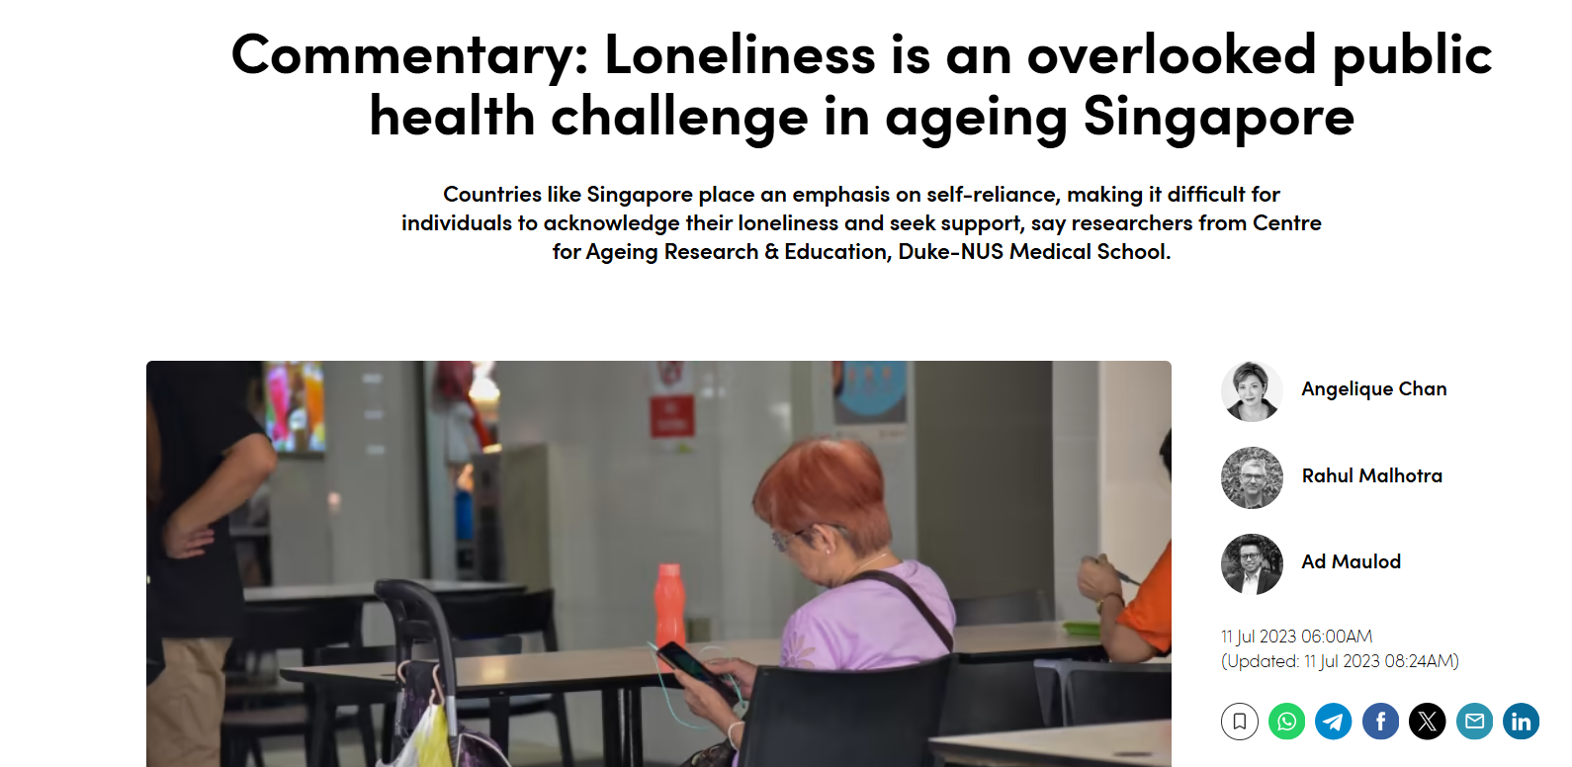
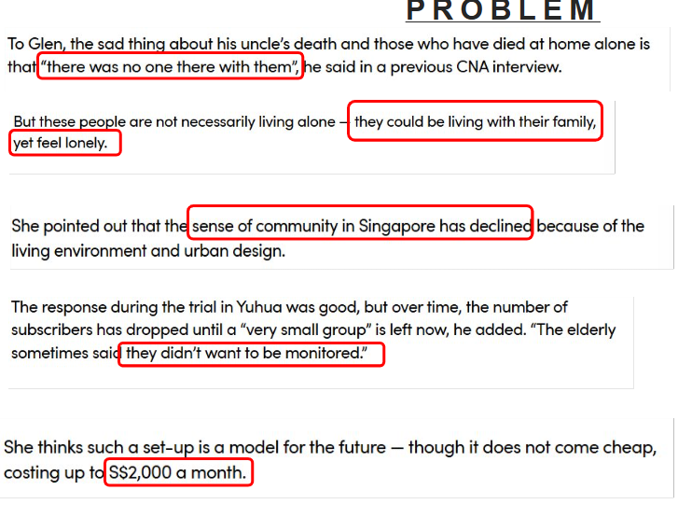
Background & Motivation
About 1/5th of Singaporeans are aged 65 and above.
In 2030, 83,000 elderly Singaporeans are predicted to be living alone.
There is an increasing trend of elderly calling helplines for loneliness and mental health issues.
The root problem is a lack of companionship.
5

Slide 6

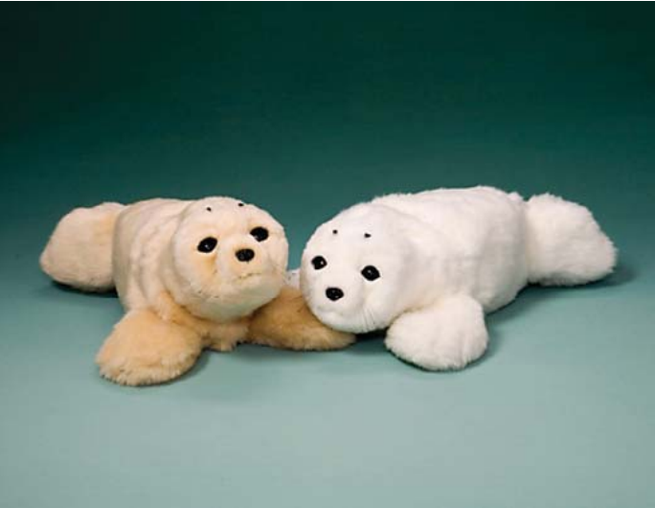

Literature Review 1(Paro)
Reduces depression and stress levels and improves social interactions among elderly users.
Tactile and aural sensors are used to perceive people's touch and responds accordingly.
Expensive
Ethical concerns such as infantilization and deception.
Paro, the therapeutic seal
Notes:
Robot Therapy refers to the use of animal-type robots (e.g., Paro the seal robot) as a substitute for Animal-Assisted-Therapy(AAT).
The therapeutic robot helped to reduce depression and stress levels and improved social interactions among elderly users.
Highly effective among dementia patients, where it helped to reduce aggressive behavior.
Human-Robot Interaction:
Paro makes use of sensors such as tactile and aural to perceive people and the environment and responds accordingly.

Slide 7
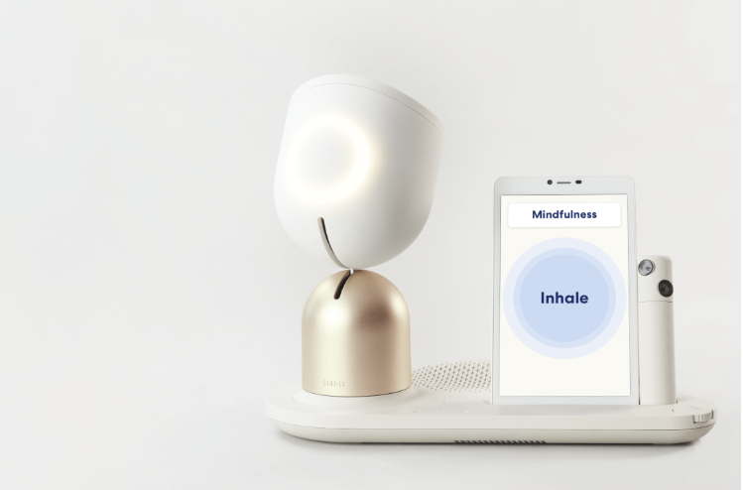
Literature Review 2(ElliQ)
Provides companionship by adapting to the elderly's personality and interests.
Affordable and highly effective in reducing loneliness(90% reported reduced loneliness).
Reduce motivation to socialize.
Over-Communication.
ElliQ

Slide 8
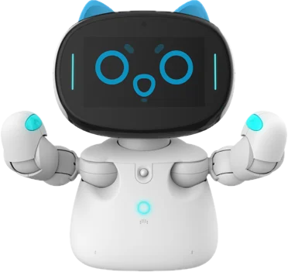
Literature Review 3(Kebbi)
Culturally tailored with engaging content.
Improves emotional connection through gestures and expressions.
Limited clinical data on healthcare settings.
Kebbi
Available for only ageing care facilities.

Slide 9
Problem Statement
To develop an elderly companion robot that alleviates loneliness and provides companionship.

Slide 10
Technical gaps and challenges
Robot | Key Gap | Challenge Summary
PARO | Intellignce & Sensing | No true AI, no adaptation, tactile-only interface
EliQ | Physical Interacton | No moblity or physical expressiveness
Kebbi | Robust Perception & Learning | Weak emotional modeling, error-prone CV/SR in real- world use

Slide 11
Project Objectives & Goals
Project Objectives:
Build a socially assistive robot that enhances user engagement, emotion recognition, and personalized interaction for elderly.
Integrate multi-modal sensing and interaction (vision and audio) to create a context-aware, emotionally intelligent robot.

Slide 12
Project Objectives & Goals
Goal | Description | What it addresses
G1: Emotional & Environmental Awareness | Enable real-time detection of user emotion through conversations. Environment awareness(eg. the layout of the house and the obstacles within each room). | Addresses the lack of ability of current robots to relate to users emotionally and adapt to different environments.
G2: Mobility | Wheeled-robot Follow the elderly around when commanded. | Addresses the inability of current robots to move around to accompany the elderly anytime and anywhere.
G3: Adapatability & Long-term efficency. | The robot adopts to the personality and interests of the elderly. Provide long-term emotional support. | Resolves the one-dimensional conversations seen in all current social robots.

Slide 13
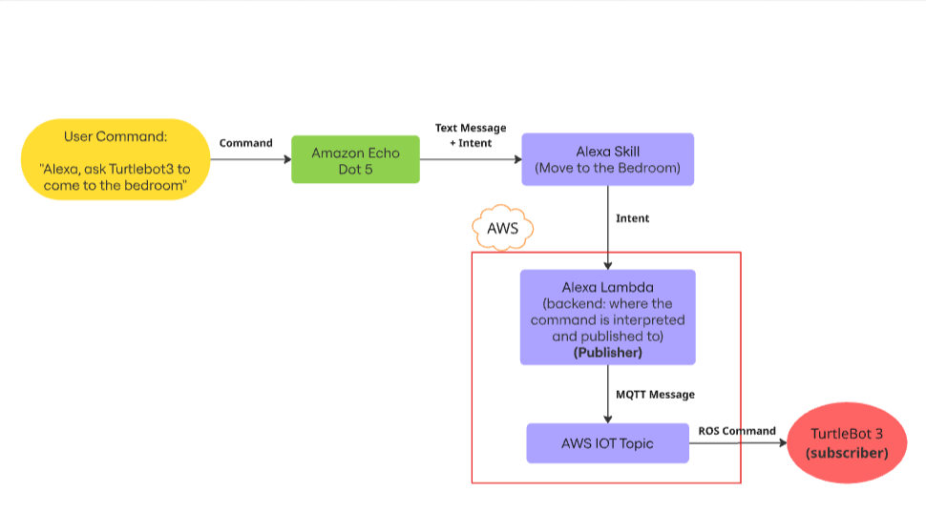
Proposed Approach(Voice Command)

Slide 14
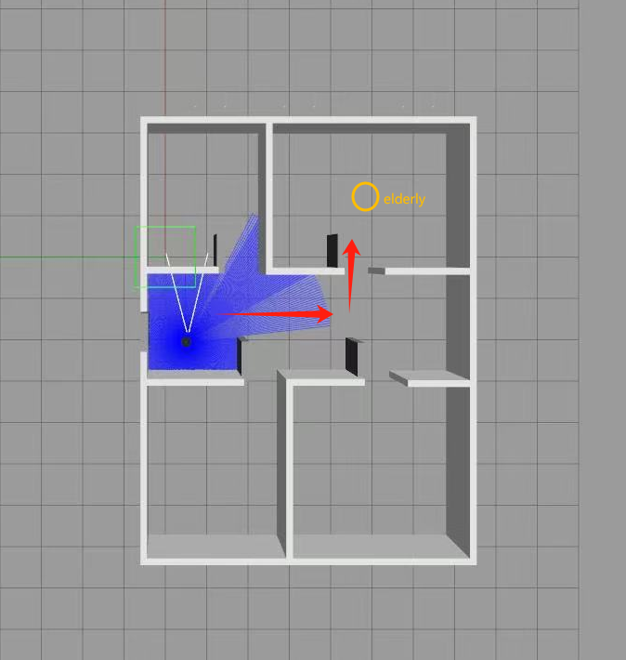
Simulation Result

Slide 15
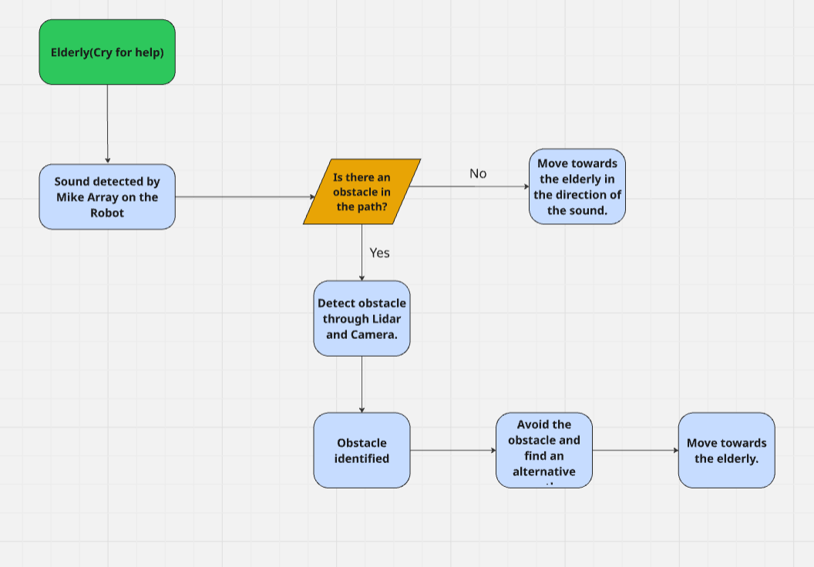
Proposed Approach(Echolocation)

Slide 16
Design Thinking Process and Methodology
Step | Application
Empathize | Collecting data on the challenges faced by elderly living alone.
Define | “How might we alleviates loneliness of the elderly and provides companionship to them?”
Ideate | Brainstorming for different concepts to enhance Turtlebot 3.
Prototype | Navigation using SLAM in a simplified home simulation in Gazebo.
Test | Deploy in a test environment, collect user reactions and iterate

Slide 17
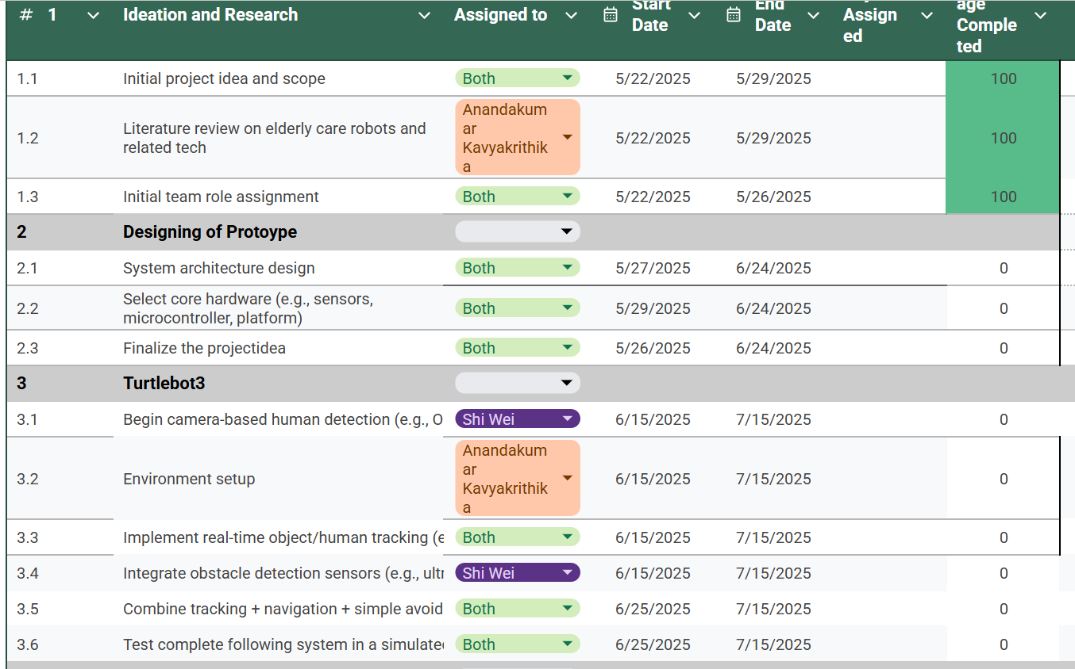
Timeline

Slide 18
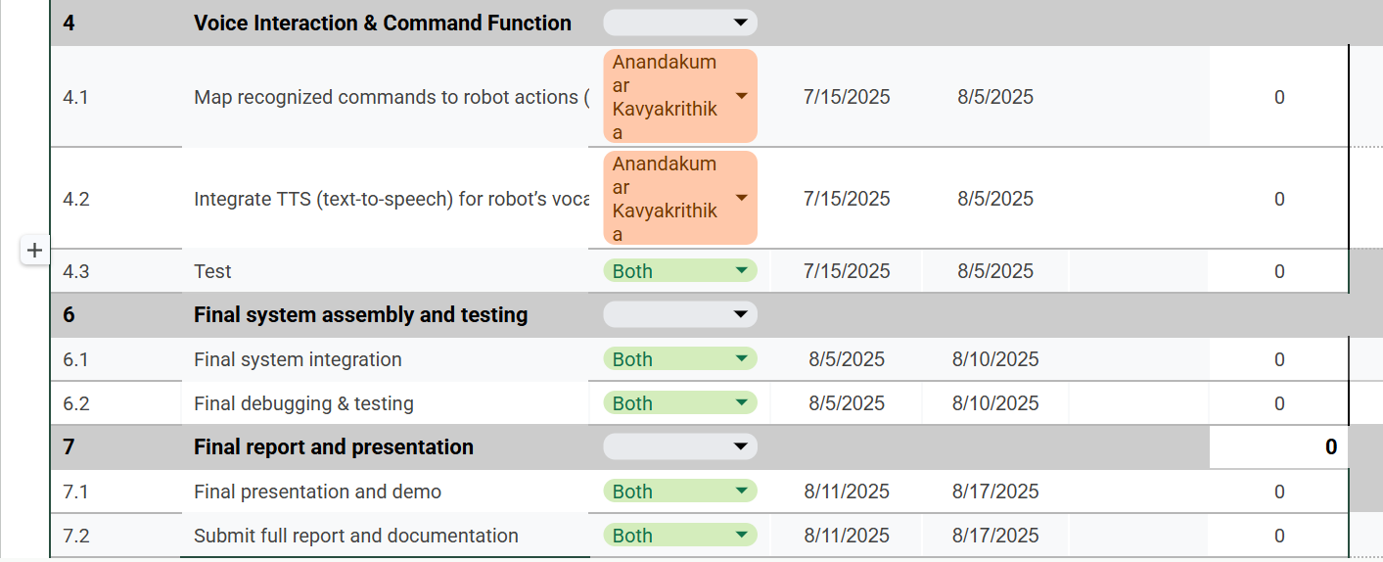
Timeline

Slide 19
THANK YOU

Slide 20
References
CNA. (n.d.). When someone dies alone in Singapore, this is what happens. [online] Available at: https://www.channelnewsasia.com/cnainsider/when-someone-dies-alone-singapore-this-is-what-happens-seniors-769486.
CNA. (2021). Commentary: Loneliness is an overlooked public health challenge in ageing Singapore. [online] Available at: https://www.channelnewsasia.com/commentary/senior-loneliness-mortality-risk-ageing-public-health-crisis-3615171?utm_source=chatgpt.com.
Shibata, Takanori, and Kazuyoshi Wada. “Robot Therapy: A New Approach for Mental Healthcare of the Elderly  a Mini-Review.” Gerontology, vol. 57, no. 4, 15 July 2010, pp. 378–386, https://doi.org/10.1159/000319015.
Tenzin Wangmo, et al. “No Playing around with Robots? Ambivalent Attitudes toward the Use of Paro in Elder Care.” Nursing Inquiry, vol. 31, no. 3, 29 May 2024, https://doi.org/10.1111/nin.12645.
spencer, terry. “Chatty Robot Helps Seniors Fight Loneliness through AI Companionship.” AP News, 22 Dec. 2023, apnews.com/article/artificial-intelligence-robot-elliq-senior-citizens-a343409477b7aea350254f94daf52eb7.
“Social Robot for Seniors in Singapore.” Silveractivities.com, 2019, silveractivities.com/kebbi-social-robot. Accessed 25 June 2025.

